Slide 1
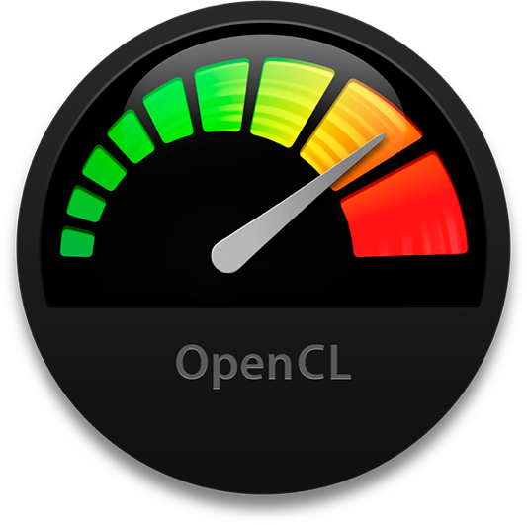
clTracer: an OpenCL pathtracer
Renato utsch, DCC UFMG

Slide 2
IMPLEMENTATIOn

Slide 3
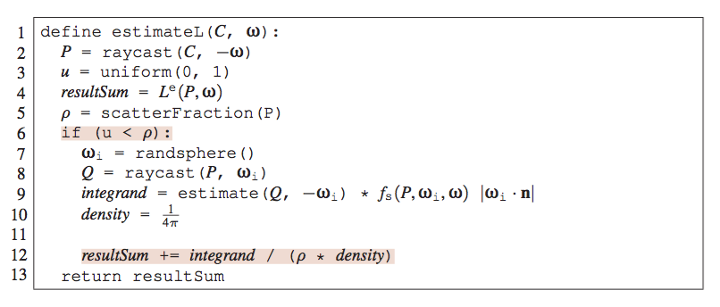
Pathtracer idea

Slide 4
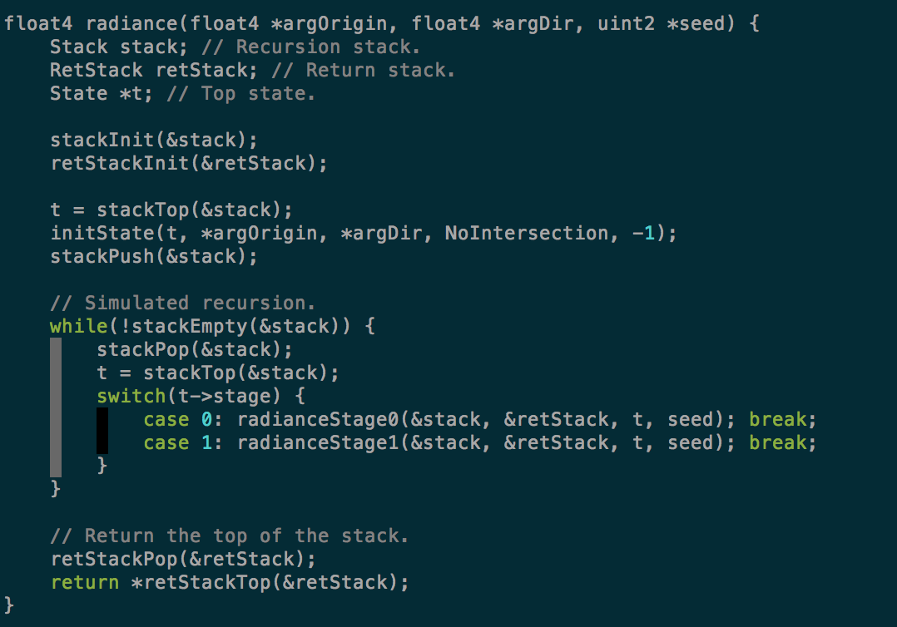
Radiance function

Slide 5
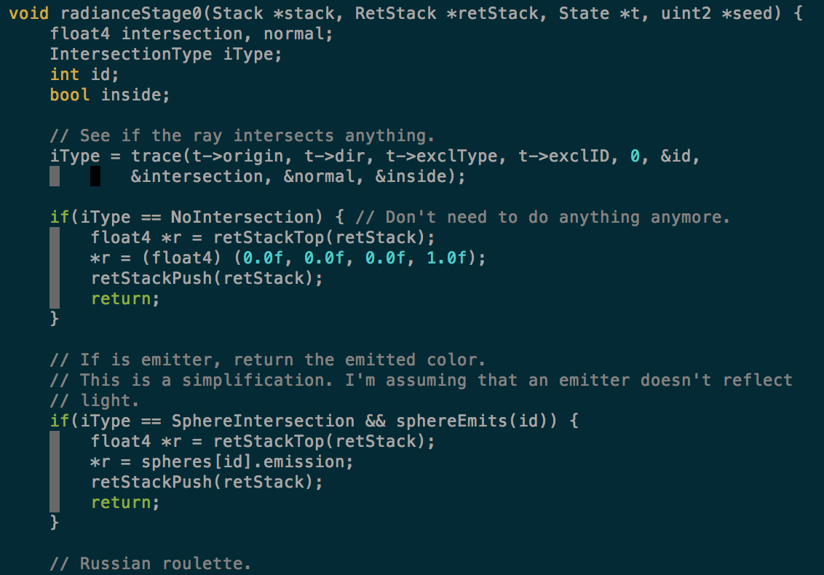
Radiance function

Slide 6
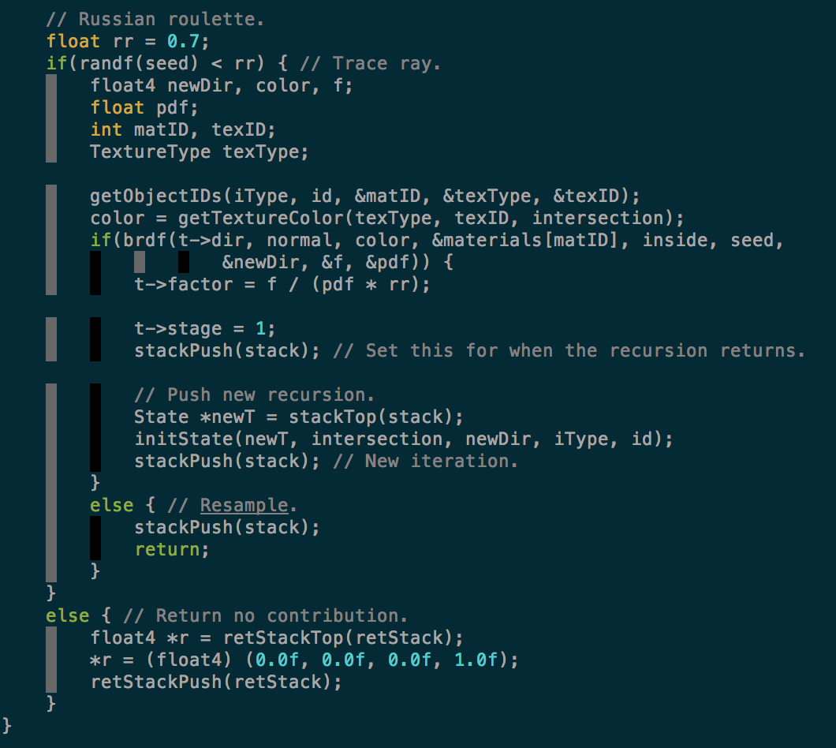
Radiance function

Slide 7
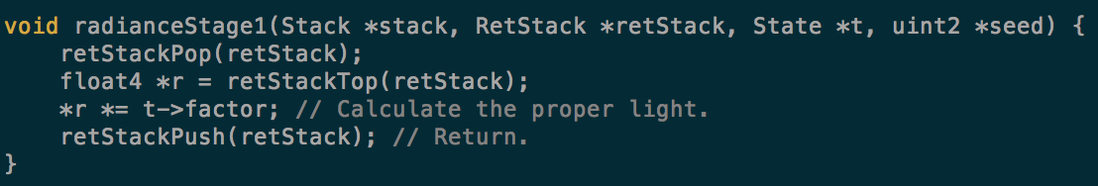
Radiance function

Slide 8
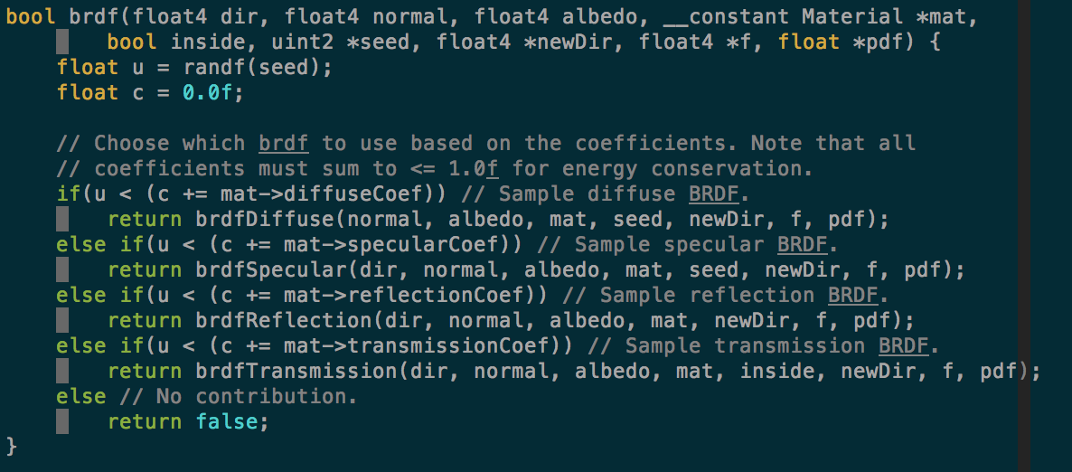
BRDF function

Slide 9
ExTRAs

Slide 10
Cltracer Extras
Anti Aliasing (Supersampling)
Importance Sampling for difuse and specular brdf

Slide 11
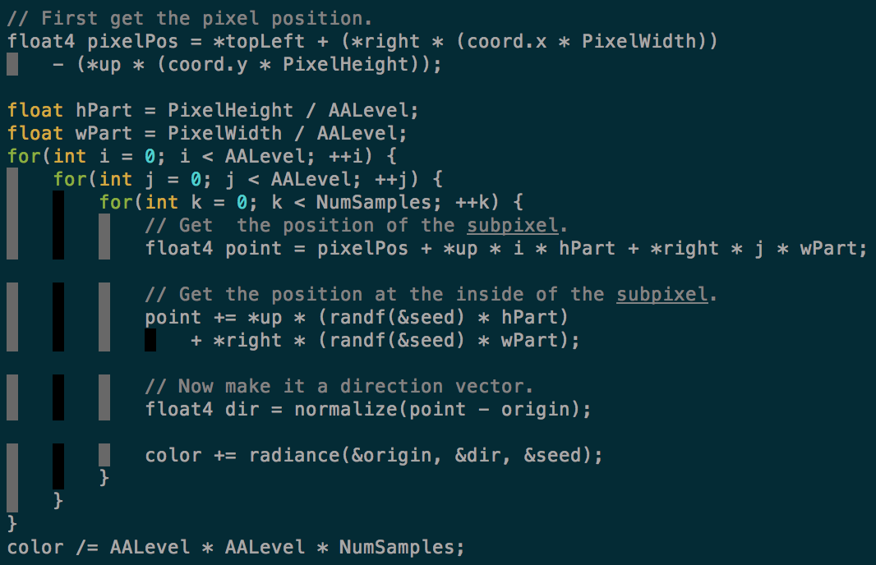
SuperSampling

Slide 12
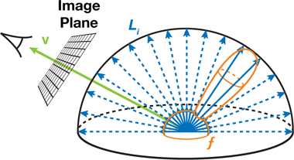
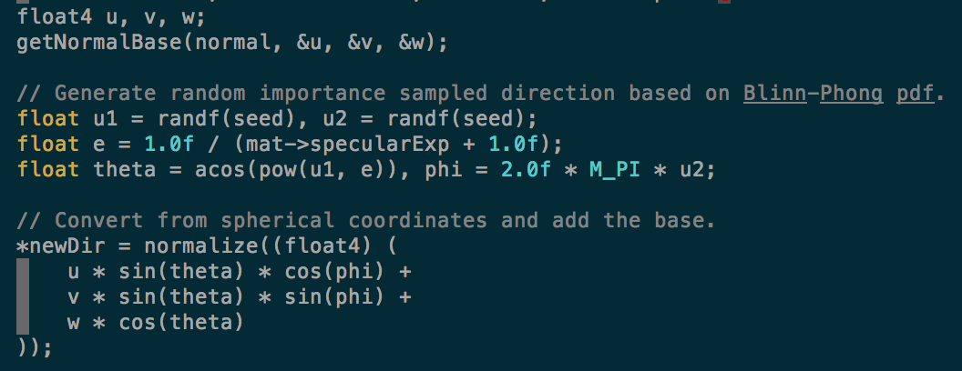
Importance Sampling

Slide 13
Comparison with raytracer

Slide 14
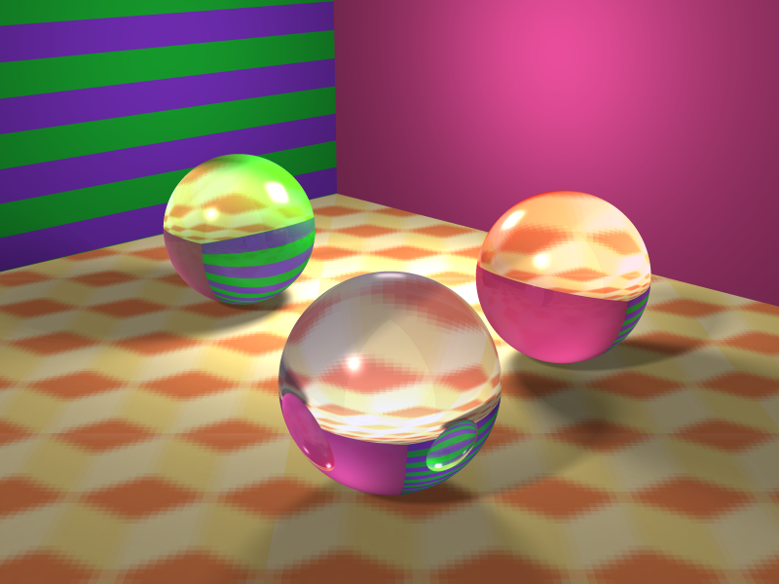
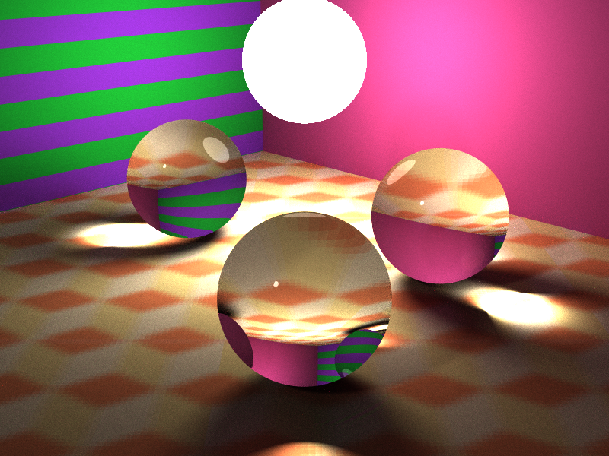
Test4
Raytracer, 64 rays per light, –aa 4
Pathtracer, 4000 samples, -aa 4

Slide 15
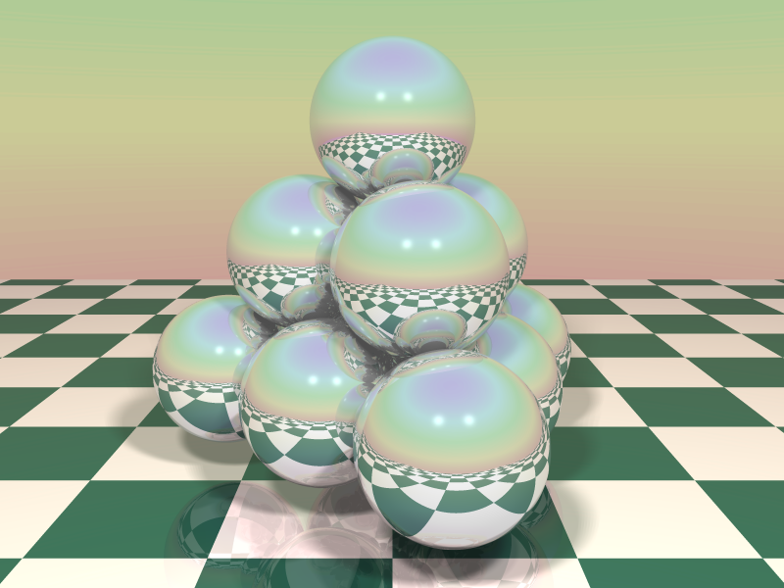
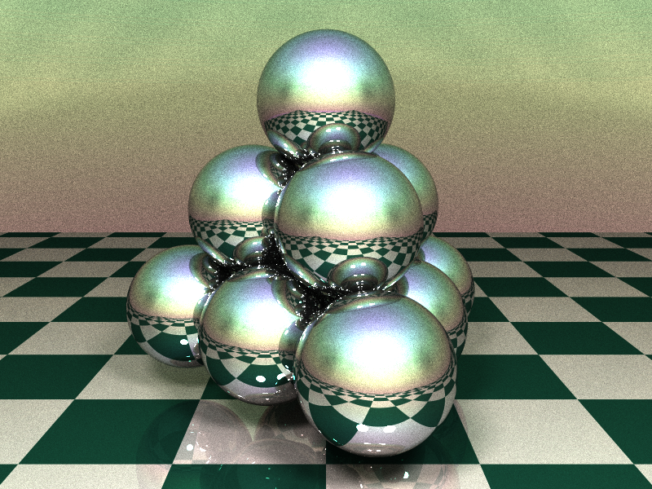
Test5
Raytracer, 64 rays per light, –aa 4
Pathtracer, 4000 samples, -aa 4

Slide 16
NUMBER OF SAMPLES

Slide 17
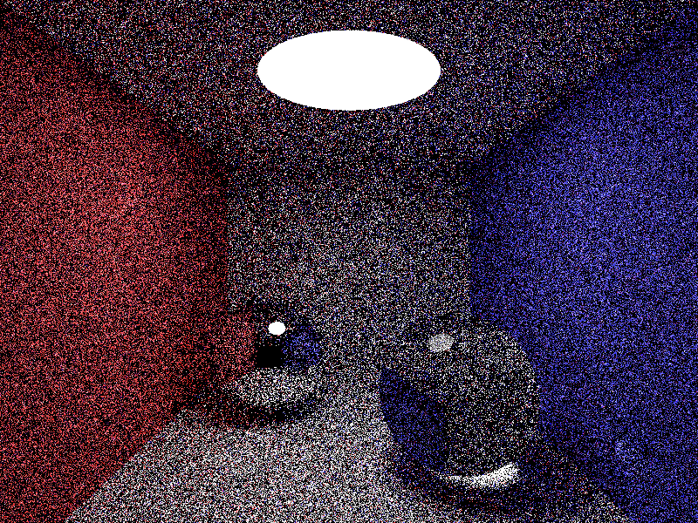
Cornell box
1 sample, -aa 4 (16)

Slide 18
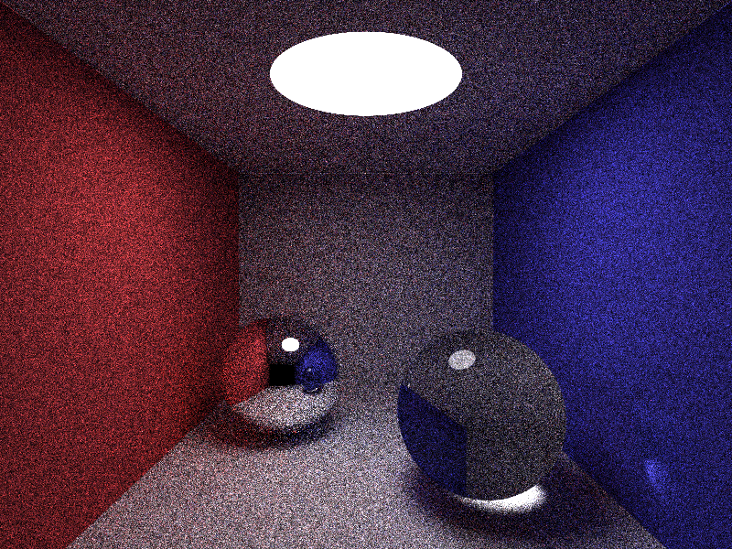
Cornell box
10 samples, -aa 4 (160)

Slide 19

Cornell box
100 samples, -aa 4 (1600)

Slide 20

Cornell box
1000 samples, -aa 4 (16000)

Slide 21

Cornell box
4000 samples, -aa 4 (64000)

Slide 22

Cornell box (2ghz intel core i7)
1 sample, -aa 4 – 6.7s
10 samples, -aa 4 – 1m 10s
100 samples, -aa 4 – 11m 25s
1000 samples, -aa 4 – 1h 53m
4000 samples, -aa 4 – 7h 22m

